Slide 1

Microservices based Solution Design and Development
Our Capabilities and Approach

Slide 2
Contents
Microservices Testing Strategy
Microservices Technology Stack
TechM Open Source Compentency
Microservices Reference Architecture
Microservices Refactoring approach in BSS/OSS ecosystem
Microservices Security Architecture
Case Studies
Microservices using DevOps
Assessment Approach for Refactoring & Development
TechM ADMS Competency
Next Steps

Slide 3
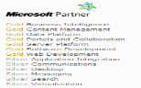




ADMS Platform Solutions Competency
Java & Open Source
Microsoft
Mainframe
Practice Highlights
800+ Experts in the Service Offering Team 3000+ Sun Certified Associates 500+ IBM Certified Associates 10,000+ developers working in projects | 70+ Experts in the Service Offering Team 1700+ Microsoft Certified Associates 4000+ developers working on projects | Over 2500+ associates working on mainframe engagements
PHP, Pearl, Python, Ajax, Spring, Struts, Wicket, Seam, JSF Weblogic , WebSphere Process Server, jBPM , Intalio Process Server, EJB Mule, Aqualogic ESB, JBoss ESB, Tibco ESB,Java Application Server, WAS CE, Tomcat IBM Portal, Liferay Hibernate, TopLink, Eclipse, BM RAD RAD, Agile, Waterfall | ASPX.AJAX,SilverLight,HTML5,WinForm,WP7 BizTalk WCF, Web Services, Enterprise Services, Service Broker SharePoint Visual Studio, TFS, Expression Studio, SharePoint designer, Visio MS Dynamics & CRM | CoolGen, Netron, Metalogic, InterTest Cobol, Easytrieve, REXX, Assembler DB2, IMS, IDMS, ADABAS Websphere/ DC/ IMS Application Server, CICS MVS,OS/90, zOS Vision Plus, Visual Age, COINS, GDF, JCL,VSAM
375+ Projects currently running 150+ Fixed Bid Projects 30% Project Managers are PMP Certified Standardized Development Frameworks (GWT, JSF, SPRING, STRUTS, Jtrac, Wicket) | 200+ Projects currently running 90+ Fixed Bid Projects 2500+ projects delivered across globe 15% PMs are PMP certified | Served more than 250 clients in past 20 years experience in development, maintenance, support, migration, Infrastructure support and legacy modernization
Application Development Solution Architecture Definition Solution Architecture Assessment Enterprise Application Integration Development Methodologies and Tools Performance Engineering SOA Services Application Migration | Application Development Application Transformation Consulting & Professional Services High End Solutioning Emerging Technologies | Application Development Application Maintenance Application Support Application Transformation Technology Consulting Performance Management System Programing SOA on Mainframe
Technology Expertise
Delivery Experience
Service
Offerings
Alliances

Slide 4
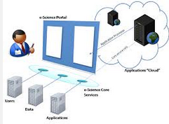
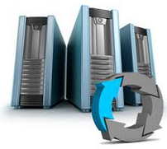
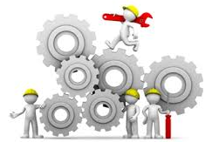
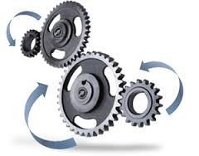
Legacy Modernization Options
1
2
3
4
Webify using Presentation Level Integration
Re-hosting
Re-platform
(Re-write/Re-engineer)
Business Process driven Integration
Migrating the application from mainframe to a compatible software stack on an open-systems platform such as like Windows/Linux/Unix, preserving the language and middleware services
Business logic and data of legacy mainframe applications remains intact in the new platform
Re-hosting services are known to help in reducing the TCO considerably
Converting legacy applications (Cobol, Coolgen, Visual Basic, Power Builder, C++ etc) to multi tier applications, based on J2EE or Dot Net
Transforming legacy application into an n-tiered application, preserving core business functionality of the legacy system and using SOA based integration
Secure browser based emulation to mainframe converting host screens to a Web look and feel

Slide 5


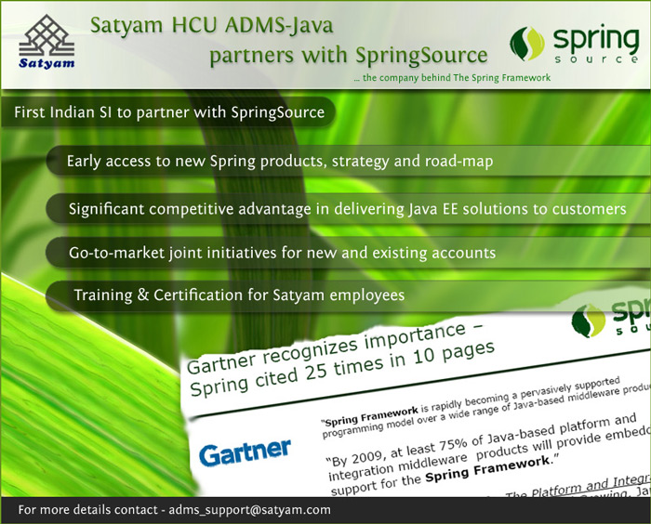

TechM Open Source Competency
Practice Highlights
Technology Expertise
10000+ Java & J2EE Developers
800+ Experts in the Service Offering Team
400+Certified Specialists for Analysis & Design
500+ Technical Architect Pool International Certifications
International Certifications
3000+ Sun Certified Associates with certifications like SCJP, SCJA, SCJD, SCWCD
500+ IBM Certified Associates on Rational (RSA, Requisite Pro etc.) & Websphere Suite of Products
Associates also certified on frameworks like Hibernate & Struts
Presentation : PHP, Pearl, Python, Ajax, Spring, Struts, Wicket, Seam, JSF
Business Process : Weblogic , WebSphere Process Server, jBPM
Intalio Process Server, EJB
Service Layer : Mule, Websphere ESB, Aqualogic ESB, JBoss ESB, Tibco ESB
& SOA
Application Server: JBoss, Weblogic, Java Application Server, WAS CE,
Websphere, Tomcat
Application Blocks : JBOSS (Cache, Rules), IBM Portal, Liferay
& Portals
Data Layer : Hibernate, TopLink, MySQL, Oracle, DB2, DB Ingress
Content Management : Confluence, Drupal, Joomla, Alfresco
Identity Management : Netigrity, Source ID, Tivoli IAM, Sun IAM
User Authentication : Java Authentication and Authorization Service
Development Tools : Eclipse, JBoss Developer Studio, IBM RAD
Processes : RAD, Agile, Waterfall
Alliances
Delivery Experience
600+ Projects currently running
300+ Fixed Bid Projects
30% Project Managers are PMP Certified
Strong delivery team providing rich Project expertise
Tight Integration between Technology Experts & Project Teams (SO Team & Delivery Team)
Standardized Development Frameworks (GWT, JSF, SPRING, STRUTS, Jtrac, Wicket)
Agile development practices (XP, Scrum, FDD)
RUP & Waterfall Delivery Methodology

Slide 6
TechM Open Source Technology Stack
Mobile Frameworks
Apache Cordova / PhoneGap
HTML 5
AngularJS
jQuery
Bootstrap
Java Script
Development
Frameworks
JBoss Portal
GWT
Ruby on Rails
Hibernate
Spring
Python
jQuery
LifeRay
JSF
PHP
Wicket
Struts
MemCache
Perl
Spring Boot
Dropwizard
JBoss Cache
Quartz Scheduler
EHCache
IDE
JBoss IDE
Eclipse
NetBeans
System Integration
Mule ESB
jBPM & Drools
Fuse ESB
Red Hat MRG
RabbitMQ
Active MQ
Esper CEP
Storm
AWS Kinesis
AXIS
JAX-WS
Specifications & Standards
OpenSSL
OpenLDAP
REST
SOAP
Web/App Servers
Apache
JBoss
Tomcat
Apache TomEE
Node.js
Big data NoSQL & Analytics
Hadoop
CouchDB
Neo4J
Revolution R
Pentaho
Active MQ
MongoDB
Jasper Reports
JFreeChart
iReport
Spark
Databases
MySQL
PostgreSQL
HSQLDB
Apache Derby
H2
Operating
Systems
Fedora
SuSE
Linux
Ubuntu
Solaris
Unix
Log & API Management,
Logstash
Elastic Search
Kibana
ZUUL
Eureka
Cloud
Platforms & Automation
AWS Cloud
Red Hat OpenShift PaaS
Red Hat OpenStack
Mule Cloud Hub iPaaS
Chef
Puppet

Slide 7
Microservices CoE Highlights
Overview
About the CoE
Right Experience on multiple technologies – SpringBoot, Dropwizards, EAP 7
200+ associates trained
Microservices
Refactoring Methodology
Containers & DevOPs
Over 10+ active customers and Discussions & workshops happening globally
Microservices CoE
Wide Range Of Technology Expertise for development and Refactoring
Migration Readiness Assessment Template
API Management
Dedicated Academy – Train & enhance resource skills
End-End Testing, Parallel Run & Transition Approach
RAD Toolkit –Expertise in RAD toolkit like jHipster to reduce the TTM by 30 to 40%
Development Initiatives
Communication Major in China
Reference architecture finalised
Canadian Banking Major
Development using Spring boot
US Telco Major
Phase 1 development with Spring boot in production
European Airline Operator
Implemented Microservices design principles
3 Dimensional scaling implemented
HA and clustering - Kubernetes
AWS ECS for containerization
3 dimensional scaling implemented
Team of 10 trained in the Netflix architecture
PoC to be kick-started
US Telco Major
Implementation of Blue Marble platform
Managing OSS/BSS ecosystem
Offering data as service / API for easy consumption

Slide 8
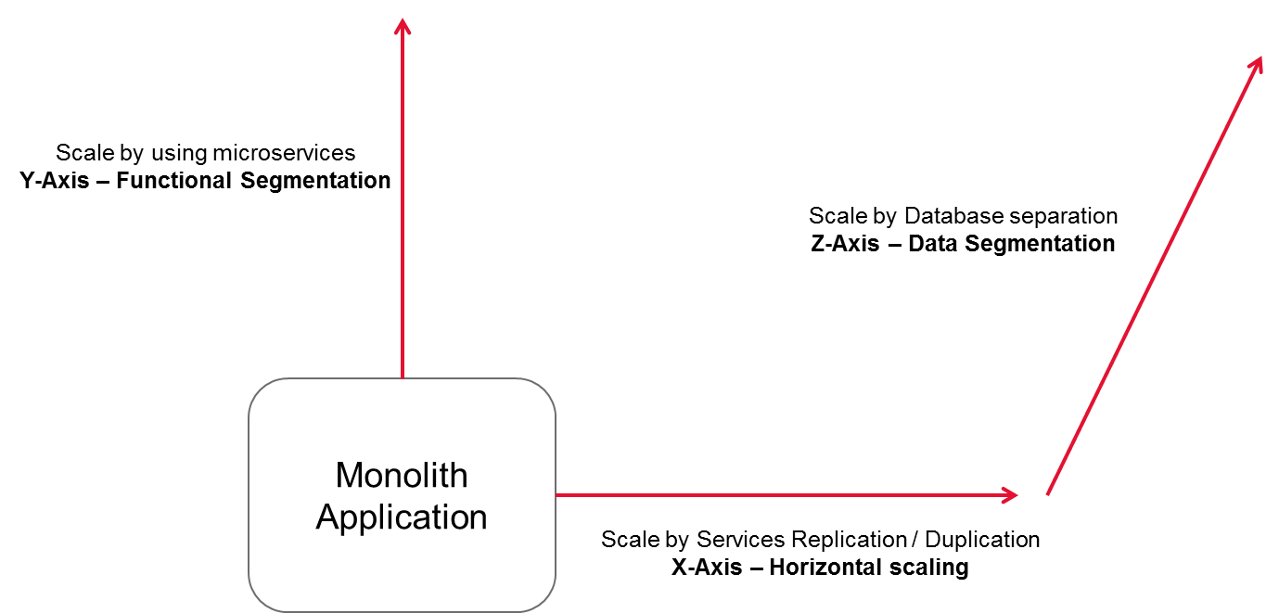
Microservices Design Principles
Design Microservice as a self-contained unit of functionality with loosely coupled dependencies on other services
Build smaller (fine grained), clearly scoped services
Single Responsibility Principle
Domain Driven Development
Bounded Context
Independently Managed
Low coupling and high cohesion
Asynchronous over synchronous
Choreography over orchestration
Ensure clear ownership for each service
Adopt “DevOps”
Low Coupling
High Cohesion
Event Driven
Error and changes seldom propagate errors and changes to dependent components
Functional Cohesion contributing to a single task
Keep own state, Use Events to notify changes and replicate data. Have own database
Core
Principles
Designed for Failure
Test for Stress and Failure
DevOps
Be prepared for service failure. Implement features to deal with issues on other services
Test under stress and with failing services
Allow individual services to be built and deployed independently
Use CI and CD

Slide 9
Advantages & Disadvantages
Faster and simpler deployment and rollback with smaller services.
Ability to horizontally scale out individual services.
Selecting the right tool, language and technology per service, without having to conform to a homogeneous environment being dictated by shared infrastructure.
Fault isolation at microservice level by shielding services from common infrastructure failure due to the fault of one service.
Well-suited for Continuous Delivery and Integration, given lower service granularity.
More autonomous teams lead to faster/better development.
Traditional divide and conquer benefits
Less tooling / IDE support
QA, particularly integration testing can be difficult.
Difficult Debugging
Higher complexity – higher fixed cost and overhead.
Heterogeneous environments - costly to maintain.
Z-Axis Scaling
Dealing with only a subset of the data.
Improves cache utilization and reduces memory usage and I/O traffic.
Improves transaction scalability.
Improves fault isolation
Increased application complexity for transaction Management
Difficult for data partitioning

Slide 10
Reference Architecture & Patterns

Slide 11

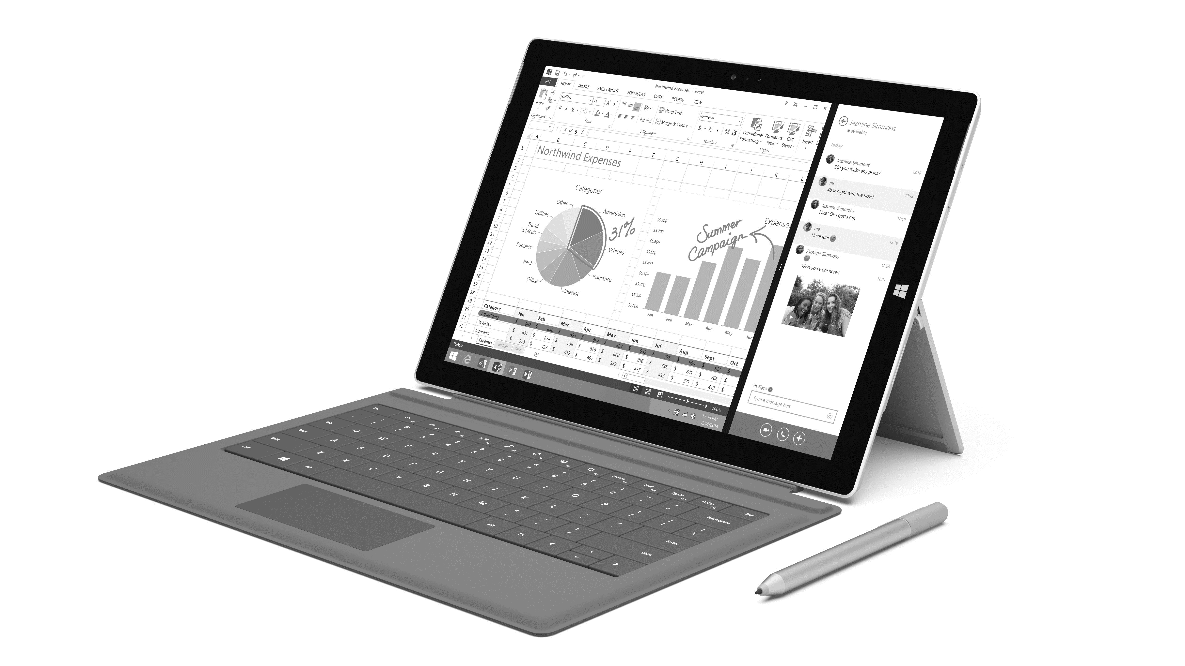
Microservices Reference Architecture
API Management
Identity Management
Service Registry
Analytics
All Service will get registered in the registry
Inter Micro Service Communication through Gateway
Throttling, Security,
Caching, Analytics
Microservices
Service
Consumers
Gateway
Product Catalog
API Gateway
Event Driven Architecture
Shopping Cart
All Service Consumers
access services Gateway
Payment Service
Web Service /REST
Shipping Service
Monitor Dashboard
ERP, CRM, CMS
In-Memory Computing
Cloud APIs, SaaS
Integration Service
Database
Containers for Deployment, Scalability & Availability
Message Broker, ESB
Legacy System
Notes:
Reference Architecture

Slide 12
Microservices Architecture – Various Patterns
Decomposition patterns
Business capability
Domain and Sub domains
Database per service - decoupling and componentisation
The API Gateway pattern – Single point of entry
Service Registry
Message Broker for Aysnc distributed transaction management
Deployment Strategies
Single Service per Host
Multiple Services per Host
Cross-cutting concerns patterns: Microservice chassis pattern and Externalized
Testing patterns
Circuit Breaker
Security - JWT
Observability patterns:
Log aggregation - ELK
Application metrics - DynaTrace
Audit logging – Log4j
Exception tracking - ELK
Health check API – Recording in tools like Sitescope or register the API in Service Registry
Notes:
Reference Architecture

Slide 13
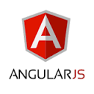
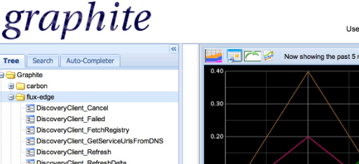


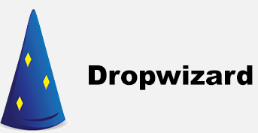
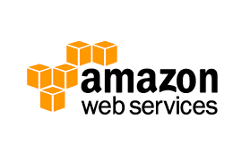





















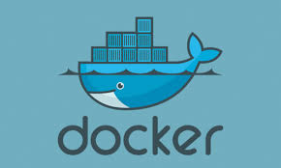




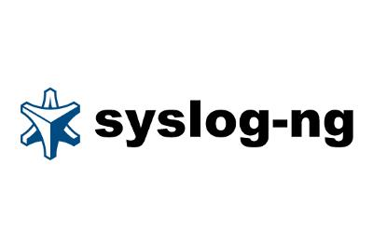

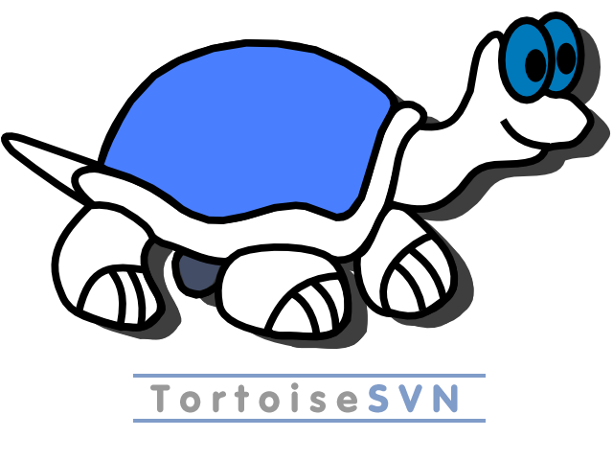

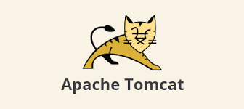








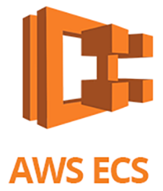
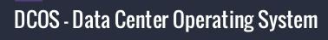
Microservices Technology Stack
Infrastructure
Tools
Development
Service Discovery
API Gateway
Load Balancer
Monitoring & Circuit Breaker
Security
Caching
Log analysis
Database
PaaS

Slide 14
Microservices – Service Fabric
Microservices
High Availability
Hybrid Operations
Data Partitioning
Container Orchestration & lifecycle management
Application Programming Models
Low Latency
Rolling Upgrades
Service Fabric
Health Monitoring
Simple programming models
High Density
Self-healing
Replication & Failover
Automated Rollback
Placement Constraints
Fast startup & shutdown
Hyper-Scale
Stateful services
Load balancing
Windows
Server
Linux
Windows
Server
Linux
Azure
Hosted Clouds/Datacenter
Windows
Server
Linux
Private Clouds

Slide 15
Why Service Fabric
Cluster management. Service Fabric automatically handles node failover, health monitoring, and other cluster management functions.
Horizontal scaling. When you add nodes to a Service Fabric cluster, the application automatically scales, as services are distributed across the new nodes.
Service discovery. Service Fabric provides a discovery service that can resolve the endpoint for a named service.
Stateless and stateful services. Stateful services use reliable collections, which can take the place of a cache or queue, and can be partitioned.
Application lifecycle management. Services can be upgraded independently and without application downtime.
Service orchestration across a cluster of machines.
Higher density for optimizing resource consumption. A single node can host multiple services.

Slide 16
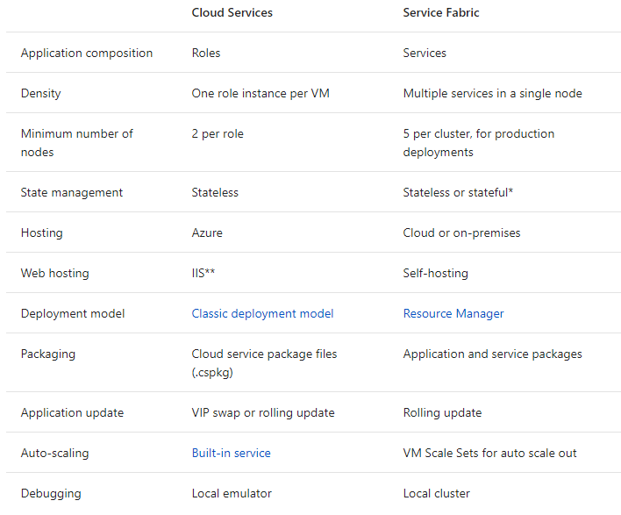
Microservices – Service Fabric

Slide 17
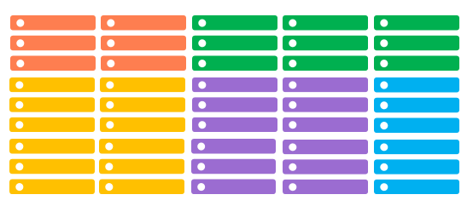
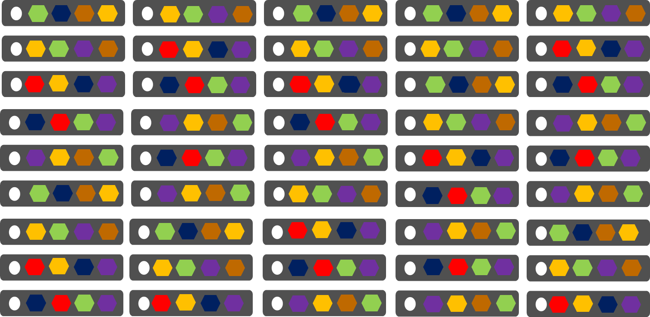
Comparing Azure Cloud Services vs. Azure Service Fabric
Azure Cloud Services
(Web and Worker Roles)
Azure Service Fabric
(Stateless, stateful or Actor services)
1 service instance per VM with uneven workloads
Lower compute density
Slow in deployment & upgrades
Slower in scaling and disaster recovery
Many microservices per VM
High microservices density
Fast deployment & upgrades
Fast scaling microservices across the cluster

Slide 18
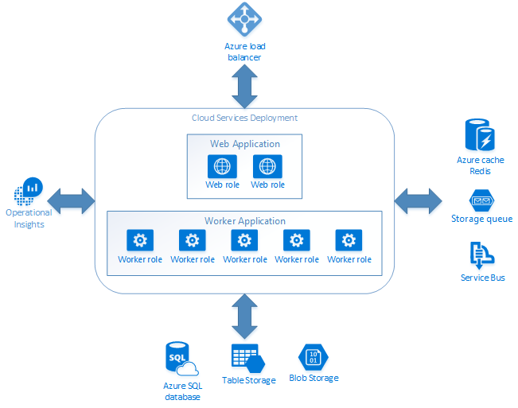
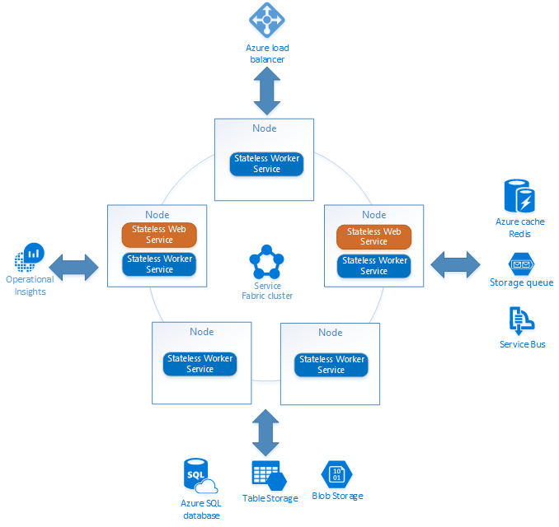
Azure Service Fabric Reference Framework

Slide 19
Azure Service Fabric Reference Framework
IIS lift and shift:
Existing ASP.NET MVC apps that you want to continue to use, put them in a container instead of migrating them to ASP.NET Core. These ASP.NET MVC apps depend on Internet Information Services (IIS).
Package applications into container images from the precreated IIS image and deploy them with Service Fabric.
Mix containers and Service Fabric microservices:
Use an existing container image for part of your application.
Leverage NGINX container for the web front end and stateful services for the more intensive back-end computation.
Reduce impact of "noisy neighbors" services:
Leverage resource governance ability of containers to restrict the resources that a service uses on a host.
If services might consume many resources and affect the performance of others (such as a long-running, query-like operation), consider putting these services into containers that have resource governance.

Slide 20
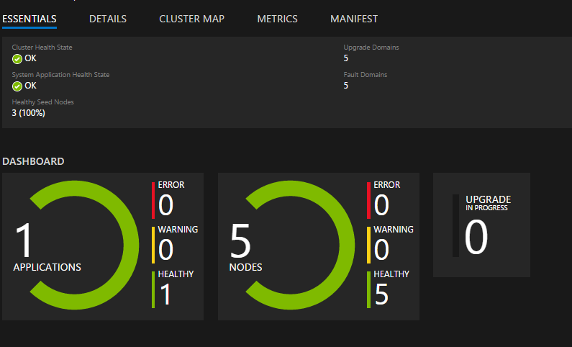
Service Fabric Explorer
Application and Service Health

Slide 21
Cluster Manager Tasks
Cluster Manager
Service Monitoring and Diagnoses
Load Balancing
Naming Service
Fault Analysis
Health Monitoring
Resource Management
Application Capacity management

Slide 22
Cluster Manager Tasks
Service Monitoring and Diagnoses
Load Balancing
Govern and address the resource manager regarding issues to adds or removes VM to balance the cluster..
Naming Service
Maintains records of named service instances and endpoint addresses they listen on that changes when services move.
Fault Analysis
Designed for testing and validating numerous states and transitions that a service will experience.
A set of metrics is automatically collected ,stored in auto created Azure account, aggregated, visualized and analysed.
Health Monitoring
Resource Management
Monitor the state of cluster and services and send reports to the health store for easy retrieval and evaluation
Application Capacity management
Tracks requirements and resource consumption by services and distribute it according to load and hardware requirement.
Manages capacity of nodes and cluster and disallows the total load to exceed the limit.

Slide 23
Service Fabric support for containers
Supports deployment of Docker containers on Linux and Windows Server containers on Windows Server 2016, along with support for Hyper-V isolation mode.
Container image deployment and activation.
Resource governance.
Repository authentication.
Container port to host port mapping.
Container-to-container discovery and communication.
Ability to configure and set environment variables.

Slide 24
Types of microservices
Micro Services
Stateless
Stateless service Model
Web API OWIN’s Service Model
Stateful
Stateful Reliable Services
Guest Executable
Stateful Reliable Actors

Slide 25
Stateless Microservice
Does not contain data that needs to be stored reliably or made highly available.
When the service moves or restarts, the value is lost.
Instances of individual service is created and deployed to ensure continuous availability.
During upgrade the instances are updated one by one and an error in the process leads to roll-back to previous version
The no of instances is mentioned in the ApplicationManifest.xml and Node.xml files.

Slide 26
Stateless Web API microservice
The Web API services are hosted in OWIN’s self-hosting instead of Microsoft IIS.
OWIN is simply a contract between .NET web applications and web servers.
Web application that is decoupled from the web server that hosts it is developed.
A service host process, an executable file that runs service code.

Slide 27
Guest executable
Treated by Service Fabric like stateless services and deployed in processes running in nodes.
Arbitrary executable, written in any language.
Benefits of running a guest executable in Service Fabric
High availability
Health monitoring
Provide upgrades with no downtime
Automatic rollback to the previous version
Eliminates the need for application to run on its own hardware
These executable do not link to or reference any Service Fabric runtime files.
They do not use any Service Fabric programming models and some such as the naming service for endpoint discovery.

Slide 28
Stateful Reliable Service
A stateful service can maintain state reliably within the service itself.
State management is done using Reliable Collections.
There are two collections supported by service fabric.
Reliable Dictionary
Reliable Queue
State(data) is divided into smaller accessible units to improve scalability and performance by partitioning.
The partition of the statefull services are replicated using the replica count to ensure high availability.

Slide 29

Microservices Architecture
Process Orchestration - BPM
Service Orchestration – ESB
Fine Grain Services
Portfolio Ecosystem
Order Management
Billing Services
UI – Docker Images / Application Server
REST
Order Management
REST
Users
Freight Management
Service Registry
Invoice Management
Message Hub
Freight Management
REST
Customer Management
Monitoring
Customer Management
REST
REST
Shipping Services

Slide 30

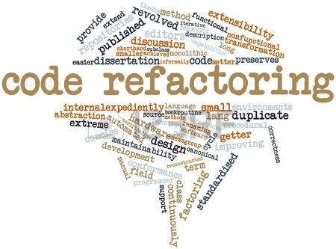
TechM Microservices Refactoring Approach
Step 1 – Application Refactoring
Split Single EAR into Multiple WARs
Use container per service like Docker
Step 2 – Code Refactoring
Refactor the WARs to even more granular levels
Untangling each REST or simple JMS service and then deploy each service as single WAR
Step 3 – Data Refactoring
Isolated "island" of a few tables joined by relationships
Table de-normalisation
Build Deploy and Manage Independently
Refactor Servlets, EJB and SOAP services
Create new services to access data from various databases

Slide 31
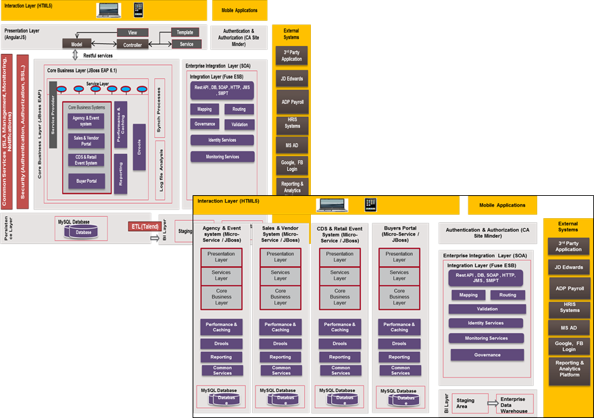
Monolith to Microservices
Monolith
Domain driven Refactoring
Designing classes using the Single Responsibility Principle (SRP)
Faster Concept to Market
Efficient Order to Activate
Domain driven – Source Code splits
Analyse the Data access Layer
Each service capable of being independent
Database analysis – Tables and Relations
Z- Axis and Y - Axis Scaling
Identify API calls to avoid Access to the other tables
Higher availability with no single point of failure
Split of tables and data
Decompose by business capability and define services corresponding to business capabilities.
Decompose by domain-driven design subdomain
Decompose by use case and define services that are responsible for particular actions. e.g. a Shipping Info offering all the details of a shipper
Decompose by resources by defining a service that is responsible for all operations on entities/resources of a given type. e.g. Service offering for Logistics network planning
Split of Database schema
Scaling at each functional and domain context
Transaction & Reporting Management
Define SCM strategy for different domains
New service Contracts
Best Fit for agile Development leading rapid TTM
Apply Design principle for Transaction mgmt
Apply Security in REST set up
Leverage of multiple technology stacks for services and databases
Create DevOps Strategy
X - Axis Scaling
Containerisation
Tactical – Parallel run
Full Scale
Microservices Architecture

Slide 32
Application Assessment - Criteria
Goals – Criticality & Benefit Index | Current Challenges - Risk Index
Agile based development Faster Release cycles Need DevOps , CI / CD Functional scaling in addition to 100% availability Need for next generation platform and to phase out exiting legacy technologies No vendor lock-ins Lower CAPEX and OPEX Easy and flexible change management at context levels High degree of automation Cloud and Open Source compatible | Coupling & Modularisation challenges Source Code Availability Challenges with database and tables split as per the new contexts NFR Management Testing and Monitoring challenges Transaction management Security Challenges movement to cloud and open source

Slide 33
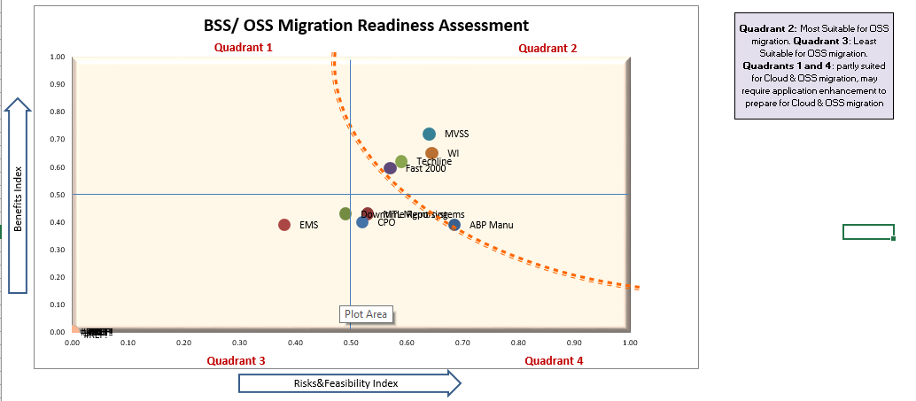
Application Assessment - Criteria
Methodology full applicable for Q2
Methodology to be tailored for Q1 and Q4
New Co-existence methodology to be applied for the application modification so that we seamlessly work in the Microservices Ecosystem

Slide 34
TechM - TCO – ROI Calculator
Monolith Cost Drivers
Licence Details
New Environment Cost Drivers
ROI Details

Slide 35
Drivers for Cost savings
Leverage of full open source stack and can migrate from licensed software's leading to more than 70% savings at licence front
Right sizing of the infrastructure and elastic load balancing to help in infrastructure optimisation
CD/CI to reduce admin support drastically to 90% of the current size
Optimisation in support team as simple code base to manage
Drastic Year on Year reduction on OPEX with right operational optimisation

Slide 36
Managing Data Consistency
Issues
Options
Loose coupling with multiple databases
Event Driven Architecture
2 phase-commit/distributed transactions
Transaction Log Tailing
Message Broker
Microservice - 1
Microservice - 2
Publish
Subscribe
Events
Events DB
Publish
Events
DB2
DB1
Events to maintain materialized views that pre-join data owned by multiple Microservices
Events
Transaction log
Transaction Log Miner
The Transaction Log Miner thread or process reads the transaction log and publishes events to the Message Broker

Slide 37
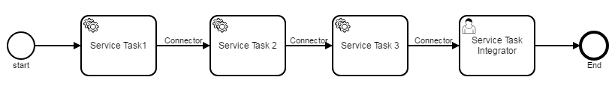
Orchestrating BPM process – For Atomicity
Orchestrate the services by implementing the BPMN process.
Service task integrator will capture the end result of the service task after trigger the events.
Service task to invoke services like REST/SOAP Services. It can be done by invoking Java code or providing a work item for an external worker to complete asynchronously
Invoke Java code by specifying java class/ Expressions / Delegate Expression
Service tasks can be invoke REST/SOAP Services by using HTTP Connectors.
When Service task is declared external, the process engine offers a work item to workers that independently poll the engine for work to do.
Each Service Task1 will invoke micro service and provide the results/output to next service task. Service Task Integrator will get the final output.

Slide 38
Query Implementation
Pattern - Command Query Responsibility Segregation (CQRS)
Command side (All CRUD Operations)
Create
Update
Delete
Query side
Queries against one or more materialized views
Views by subscribing to the data change events

Slide 39
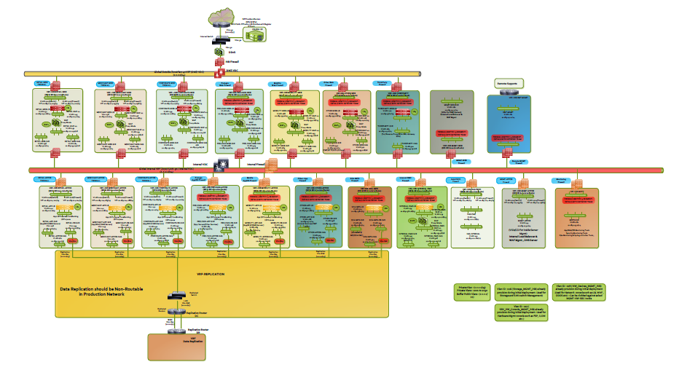
Indian Banking Major – Deployment Architecture Segregation & Functional decomposition

Slide 40
Microservices Deployment Architecture
JAR based
Outer Load Balancer
Ngnix / HA proxy
Ngnix / HA proxy
Ngnix / HA proxy
Spring Boot Jar – Port1
Spring Boot Jar – Port 2
Spring Boot Jar- Port n
Spring Boot Jar – Port1
Spring Boot Jar – Port 2
Spring Boot Jar- Port n
Spring Boot Jar – Port1
Spring Boot Jar – Port 2
Spring Boot Jar- Port n
Microservice -1
Microservice -2
Microservice -n
Container based
Outer Load Balancer
Ngnix / HA proxy
Ngnix / HA proxy
Ngnix / HA proxy
Spring Boot container
Spring Boot container
Spring Boot container
Spring Boot container
Spring Boot container
Spring Boot container
Spring Boot container
Spring Boot container
Spring Boot container
Microservice -1
Microservice -2
Microservice -n

Slide 41
Microservices Design Patterns
Aggregator
Proxy
Chained
Load Balancer
Load Balancer
Aggregator
Proxy
Load Balancer
Service –1
WAR
Service –n
WAR
Service –1
WAR
Service –n
WAR
Service –1
WAR
Service –n
WAR
DB
DB
DB
DB
DB
DB
Branch
Asynch Messaging
Load Balancer
Load Balancer
Service –1
WAR
Service –2
WAR
Service –1
WAR
Service –2
WAR
DB
DB
DB
Queue
DB
Service –3
WAR
Service –4
WAR
Service –3
WAR
Service –4
WAR
DB
DB
DB
DB

Slide 42

Microservice security with OAuth 2.0
Authorization Server
API Gateway
JWT Access Token
Micro Services
REST/ JSON
User Profiles
JWT
JWT
Supplier Mgmt. Service
JWT
JWT
Plant Mgmt. Service
Client
JWT
Transporter Mgmt. Service
JWT
Associate Mgmt. Service
JWT
KPI Service
Actors in OAUTH 2
Microservice security with OAuth 2.0
Resource Owner (RO): The entity that is in control of the data exposed by the API, typically an end user or Administration
Client: The mobile app, web site, etc. that wants to access data on behalf of the Resource Owner
Authorization Server (AS): The OAuth server that issues tokens
API Gateway(RS): Exposes the services i.e. APIs
The API-gateway style is a single entry point for all client requests.
The Client requests access to the Resource y calling the Authorization Server and obtains the access token (byreference token). Then send the access token to the API-gateway along with the request.
Token translation at the gateway - API-gateway extracts the access token and sends it to the authorization server to retrieve the JWT (by value-token).
The gateway passes this JWT along with the request to the microservices layer.
JWTs contains the necessary information to help in storing user sessions, etc.
The request will be served and response will send back to client

Slide 43
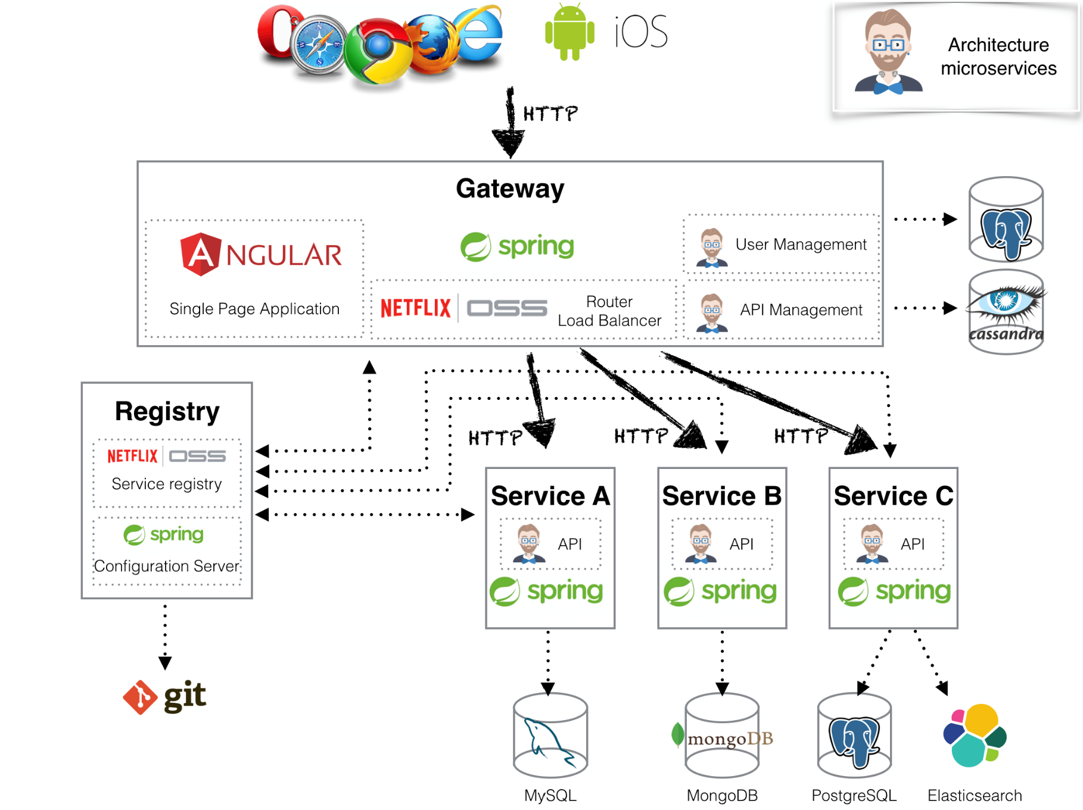
JHipster Architecture - RAD

Slide 44




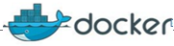

Microservices with Open Source DevOps
Build
Code Quality Checks
Central repository
Supplier Management
Plant Management
Supplier Management
Plant Management
Unit Test
Docker Images
Transporter
Management
Group & Session Management
Transporter
Management
Group & Session Management
KPI Management
Bin Content Management
Associate Management
KPI Management
Start the services
Associate Management
Bin Content Management
Java image
Oracle Image
HAProxy image
ZUUL Image
Nginx Image
Eureka Image
Java image
Oracle Image
ZUUL Image
HAProxy image
Nginx Image
Eureka Image

Slide 45
Microservices Testing Strategy – Bottoms UP
Domain based testing
Tests closer to the code
Maximise Test Coverage
Early E2E Integration Testing
Mock Testing
Performance & Security Testing
Unit Testing
Testing the Refactored services
Test the domain
Contract Test Layer
End Point Service
Black box testing
E2E Integration
E2E user journey testing
Consumer Driven Contract Testing
Maximise Code coverage
Response Testing
Dependency Testing
Testing E2E integration use case between the services
Identify the external Testing
E2E External system testing
UI Testing
E2E use Journey driven through UI
Include 3rd party External Integration
Logging
Other Details
Inter service Effects
Right error handling
Look & Feel
NFR Testing

Slide 46

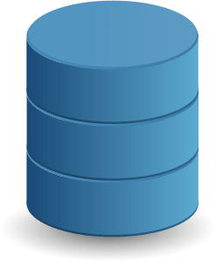




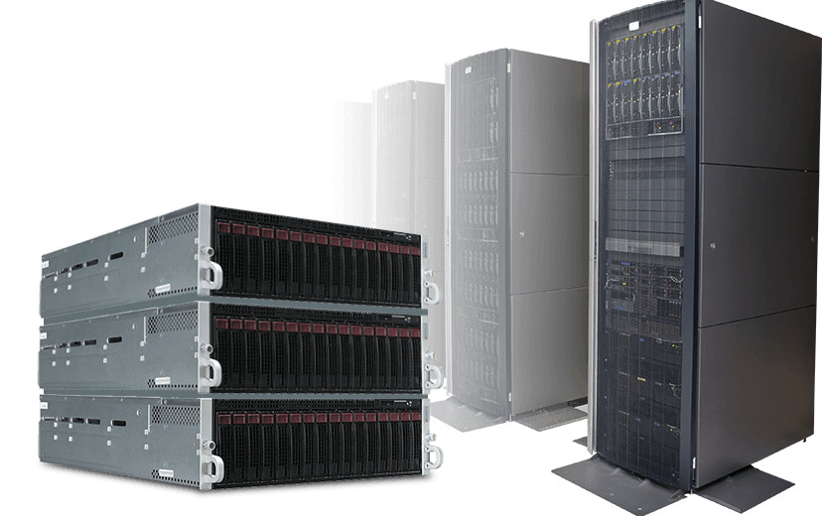

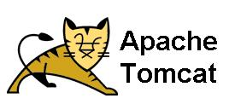
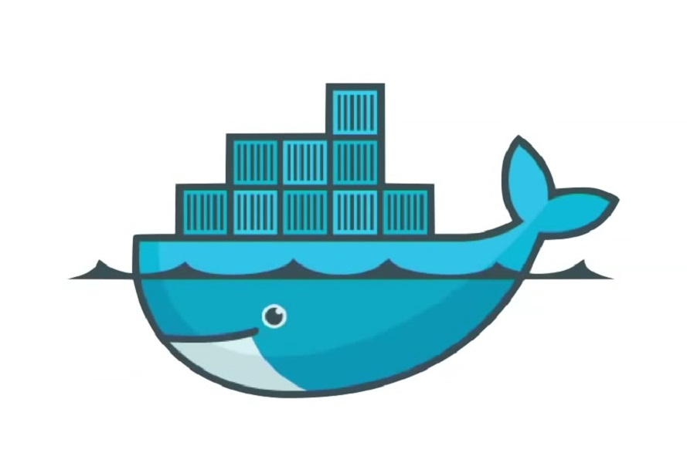
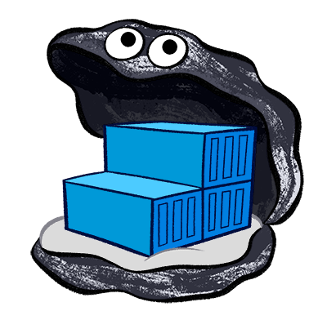

End to End Deployment Pipeline
Source code management
Build Tools
Code Quality Analysis
Unit Testing
Code Coverage
Store valid binaries, packages
Poll SCM
Validate Build
Sanity Checks
Validate Test Scripts
Code Coverage
Check out code and build
Code Quality Check
Unit Test
Code Coverage Test
Packaging and archiving
Continuous Delivery Process
Deploy to Production Environment
Acceptance Testing
Deploy to Pre-production environment
Integration Testing
Deploy to Test
Convert to Image and store
Pre-prod Environment
User Acceptance Test
(UAT)
Pre-prod Environment
Testing Frameworks
Test Environment
Docker Registry

Slide 47
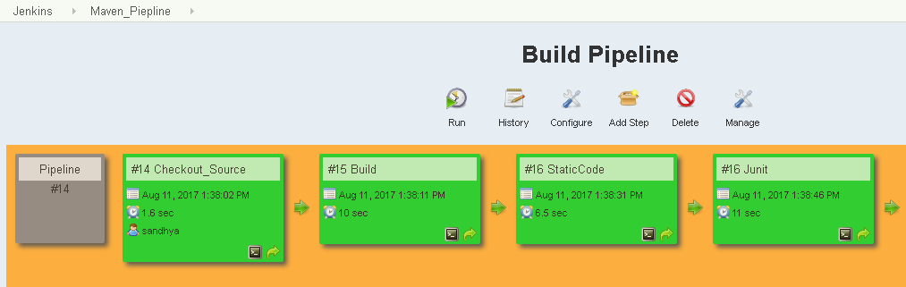
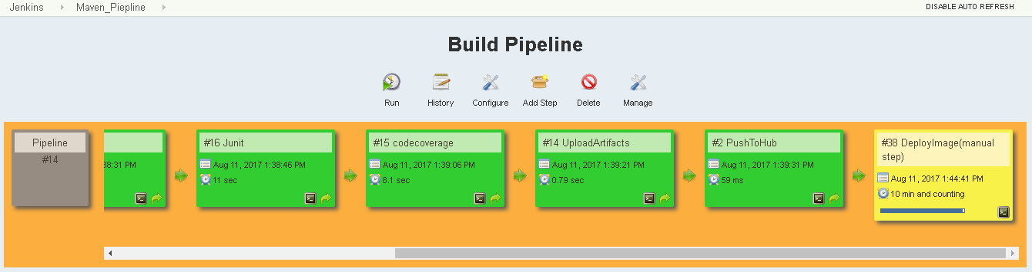
Enlarged View - Jenkins

Slide 48
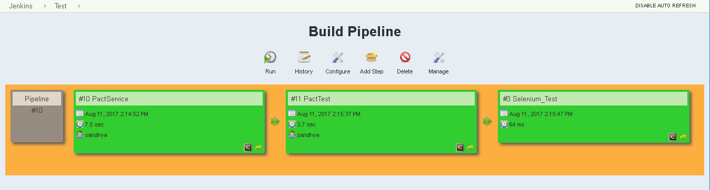
Contract Based Testing – PACT Tool

Slide 49


Microservices Testing Strategy - Tactical Parallel Run Strategy
Selected System Users & Admins
All System Users
Old System –
Production
New System – Pilot Deployment
Monolith Application
Micro services Architecture
Common App Database
Compare results for Six weeks
On Satisfactory Results
No
Continue Parallel Run
Yes
Yes
Old System – Sun Set
New System – Full Scale Deployment

Slide 50
Containers and Orchestration

Slide 51

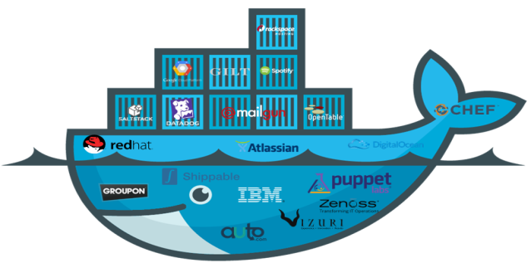
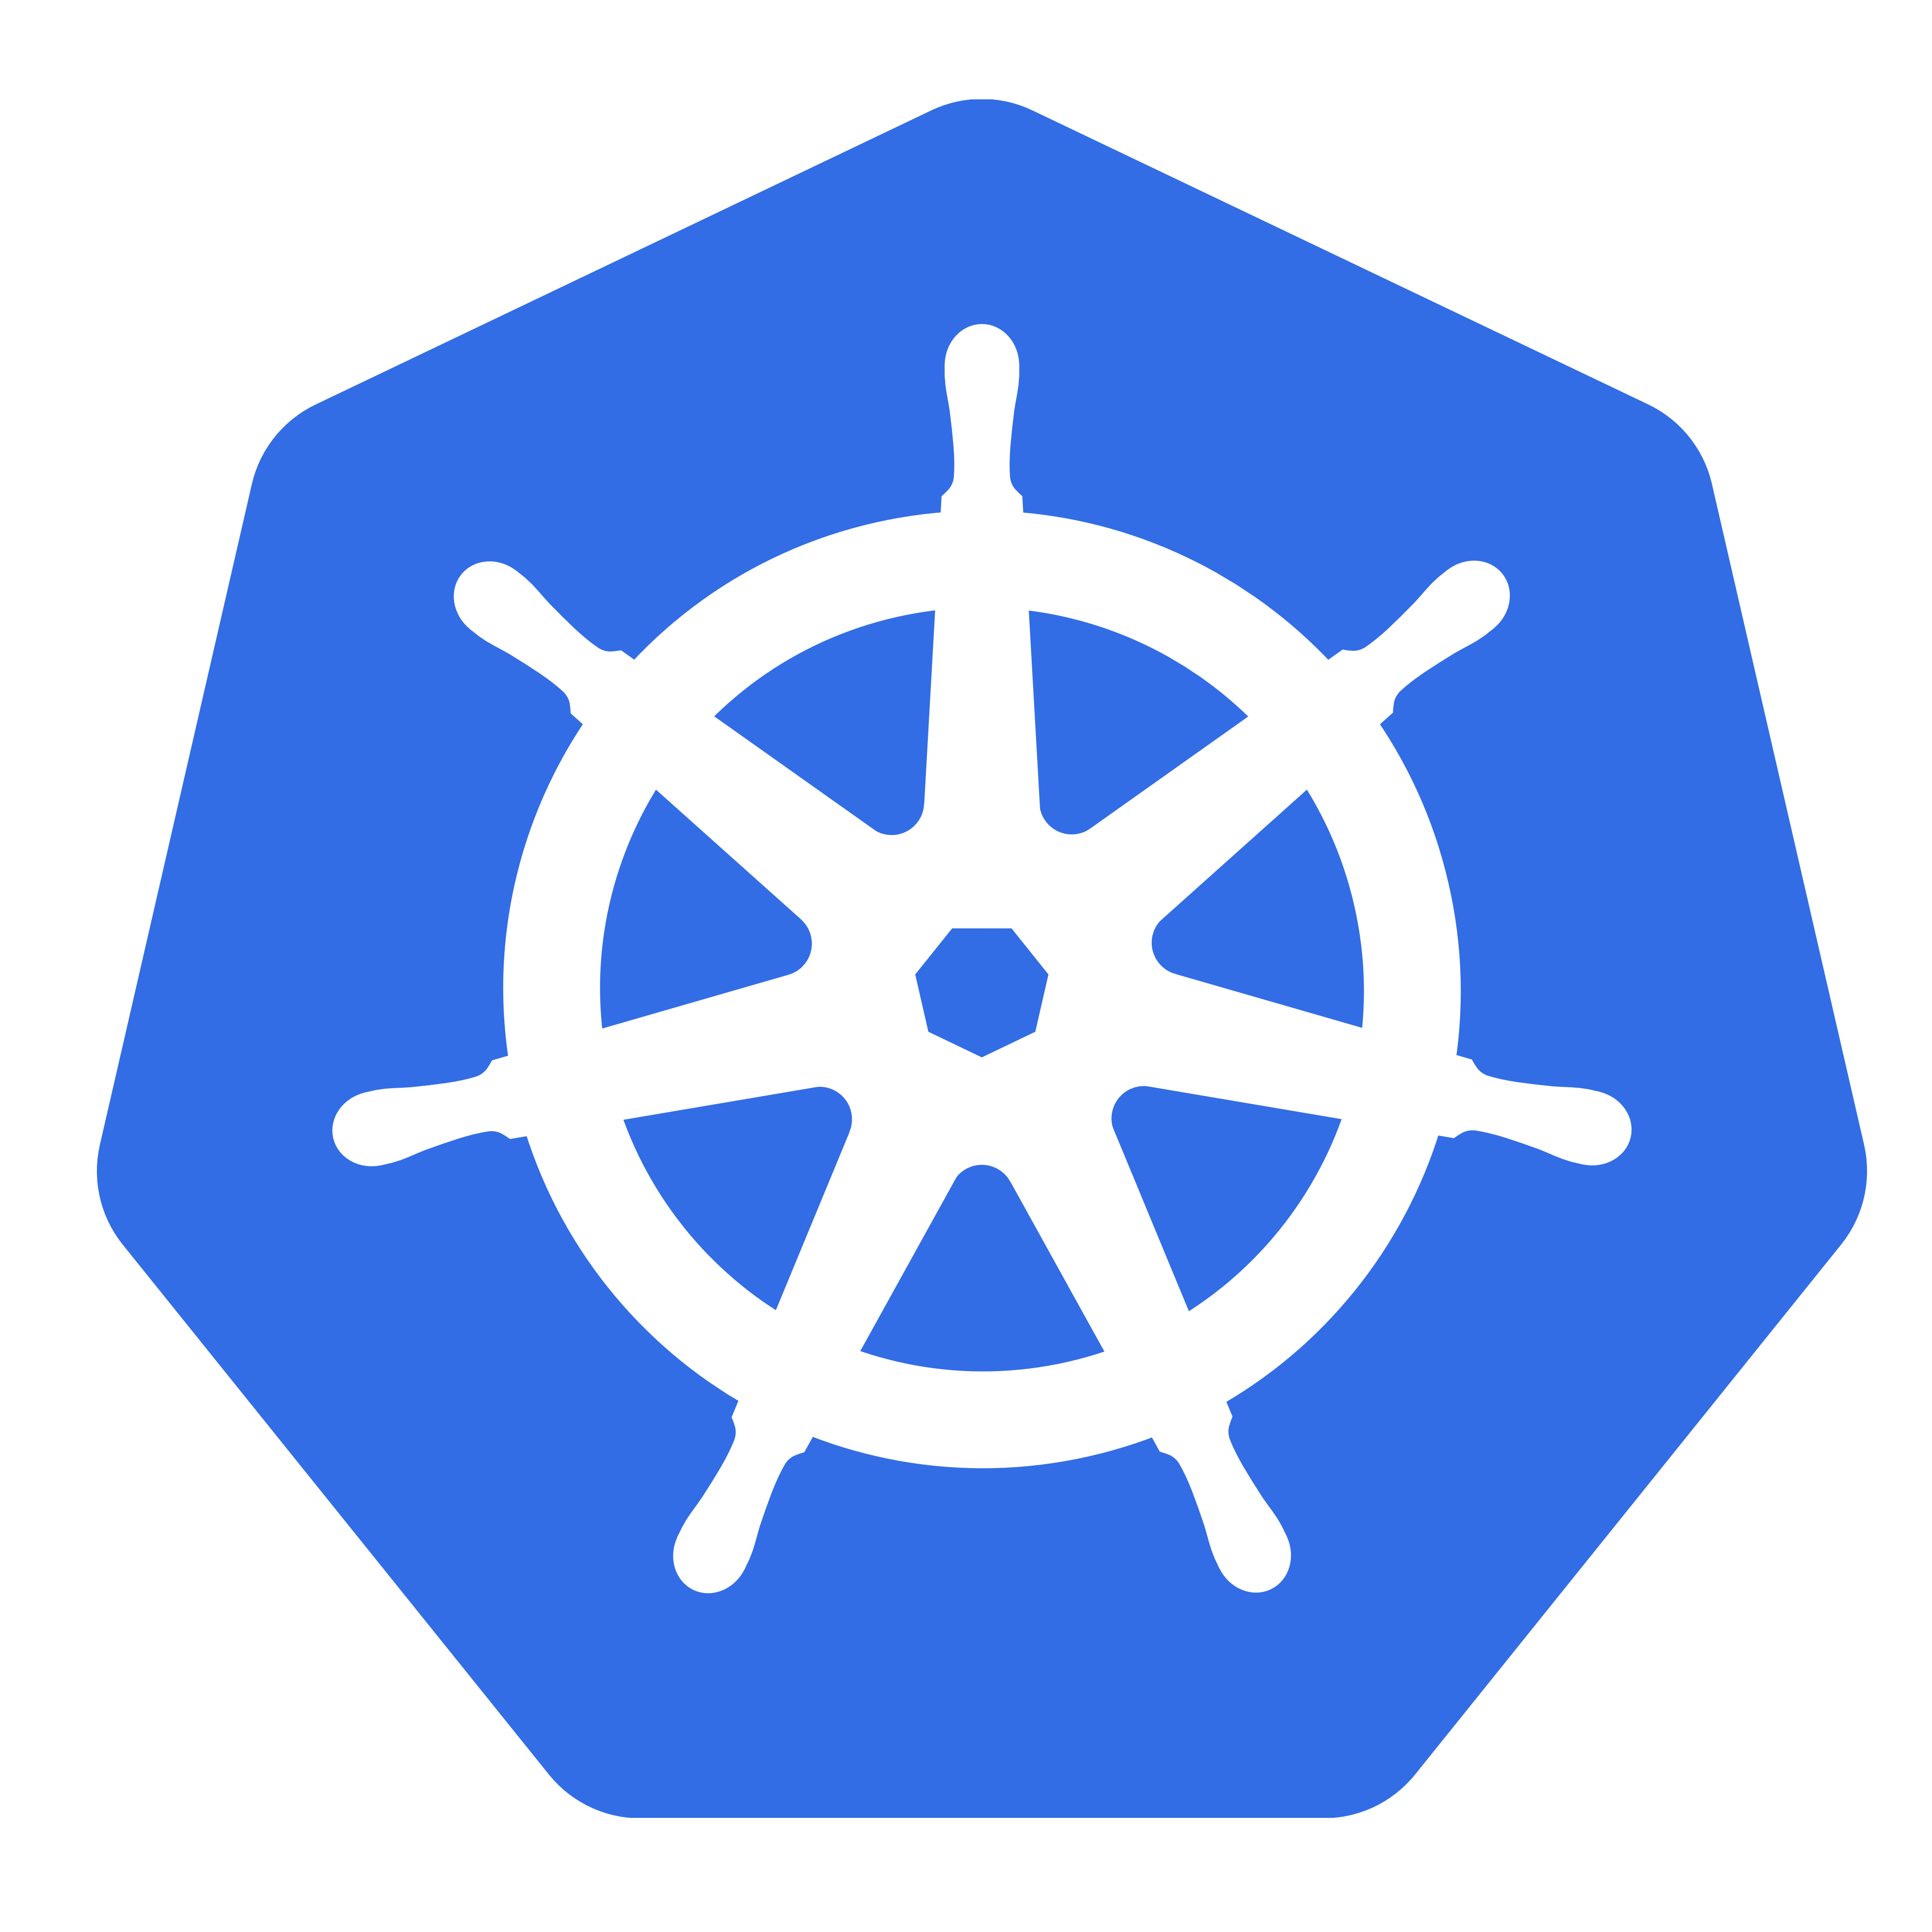



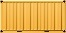




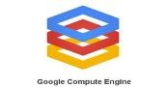

Containers – Powering Microservices Build, Ship, and Run
Apache MESOS
Red hat Open Shift
Kubernates
Docker
Docker
Docker
Docker
Docker
Docker
Source Code Repository
Analytics
DB
Linux OS
Linux OS
Linux OS
Source
Amazon ECS
Prod Machine
Prod Machine
Prod Machine
DockerFile
Docker Swam
Infrastructure Management
Docker Hub
Users
Collab
Physical
Docker
Dev
Provenance
Policy
Docker
Docker
Docker
Boot2Docker
Build
Ship
Docker
Docker
Docker
Mac/Win Dev Machine
Registries
Public
Curated
Private
VM
VM
VM
Docker
Docker
Infrastructure Management
QA
Linux OS
Docker Hub API
QA Machine
Virtual
Third Party Tools
TEST
TEST
++
Run
Staging
TEST
TEST
Cloud
TEST

Slide 52
Case Study

Slide 53
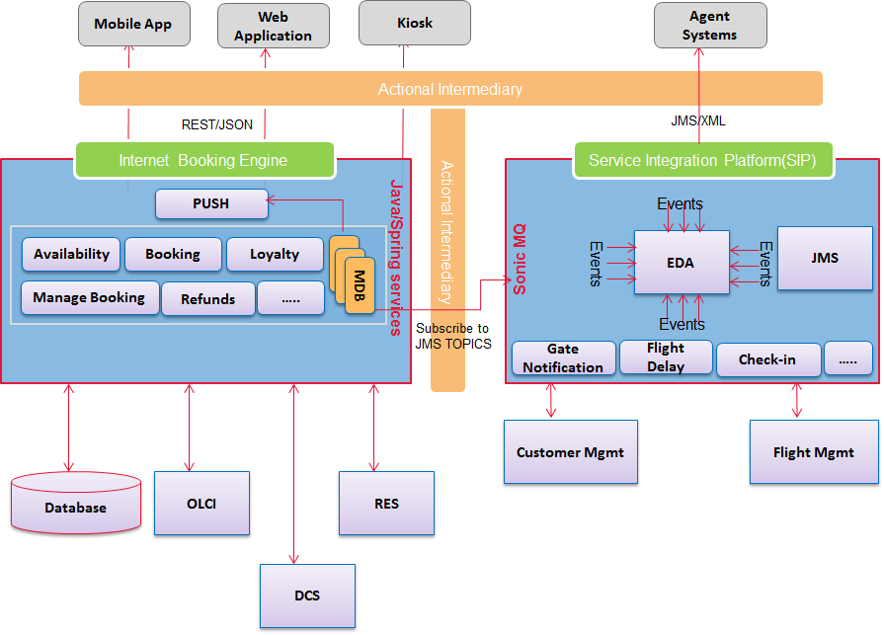
Service Integration Platform for Airline Major
Project Overview
Technology Stack
Channels: Multi Channel (Web and Mobile)
Service Integration Platform :
Design and build the Micro Services Architecture for Airline major to serve the Airline Business operations that includes Flight Reservations, DCS and Customer Loyalty services etc.
Multi-channel support
Technology Stack
Java/JEE, Spring, Apache CXF
Weblogic Server, Oracle Database, Sonic ESB
SOAP & RESTFul Services
JUnit for Unit testing; Mocking frameworks – Mockito
Application Server – Weblogic Server; Oracle Database
SOAP UI for testing the web services
JMeter for performance testing
Continuous Integration – Jenkins
Solution Highlights
Technical Architecture
Loosely coupled and Self-contained services
Easily Scalable and extendable
Highly secured and configurable for throttling & monitoring
Each service can be independently tested and deployed using Continuous Integration, Testing, Deployment and Delivery pipeline.

Slide 54
Transformation Sample – Airline Major
AS - IS
New Micro services Architecture
Mobile App
Web Application
Kiosk
Mobile App
Web Application
Kiosk
REST/JSON
SOAP/XML
AI Layer
Load Balancer
OAUTH
API Gateway
Internet Booking Engine
Application Layer - EJB services on Web logic Server
Load Balancer
Processing Components – Tightly coupled EJBs
Availability Mgr.
Online Check-In Mgr.
Booking Mgr.
MMB Mgr
XSB Mgr
……
Functional Components – Tightly coupled EJBs
Check-In
Booking
Loyalty
Customer
RES
Payments
Service 1
Service 1
Service 1
Service 1
……
DCS
Loyalty
Service 2
Service 2
Service 2
Service 2
Service n
Service n
Service n
Service n
Database
Loyalty
DCS
RES
DCS
RES
Loyalty
OCD

Slide 55
Transformation Sample – Airline Major
Check in
Booking
X- Axis Horizontal Scaling
Availability Mgr
Check in Mgr
Y- Axis : Functional Segmentation
MMB & XSB
Booking
…………….
Booking
Loyalty
Customer
Booking
Z- Axis : Data Segmentation
Store
Store
Store
Store
Store
Monolith Application
Microservices Architecture

Slide 56
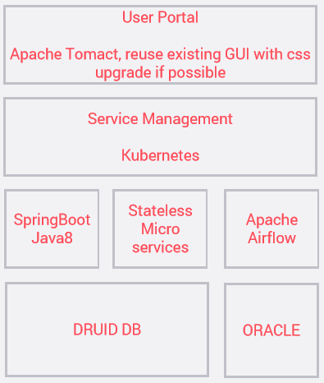
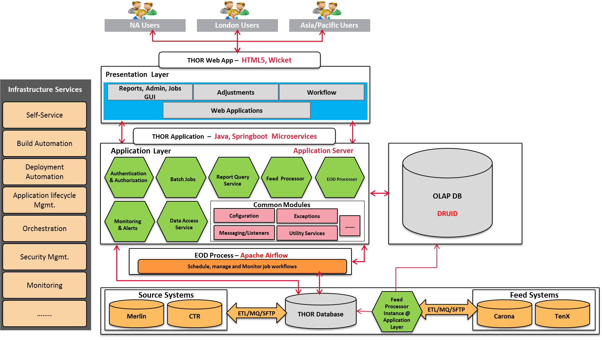
Canadian Bank – Accounting Application
Objective
Functionally decoupled and self-contained services
Restful web service design for easy integration
Easily scalable and extendable
Highly secured and configurable for throttling & monitoring
Easily configurable for each region
Technology Stack
CI/CD - Jenkins

Slide 57
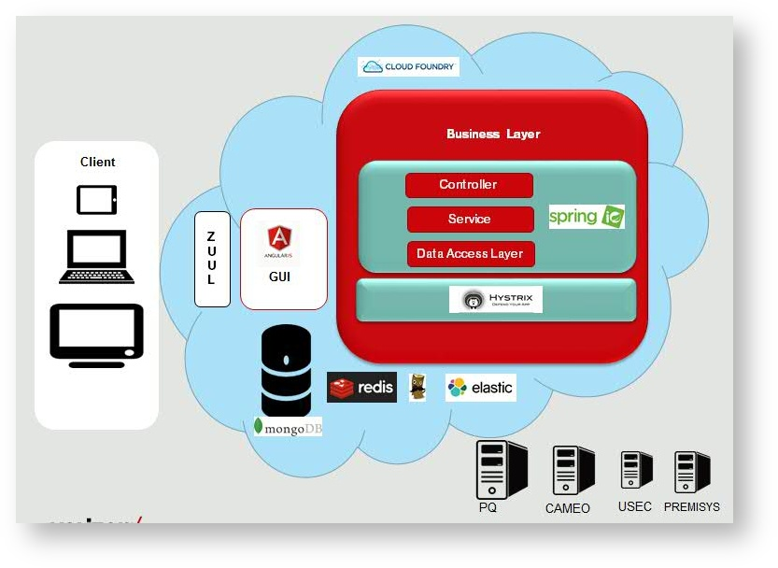
Service Integration Platform for Telecom Major
Project Overview
Technology Stack
Technology Stack
Service Integration Platform :
Design and build the Micro Services Architecture for Telecom major to serve the RFP in Telecom Business
Multi-channel support
Java/JEE, Spring Boot, Angular JS
Tomcat, Mongo Database
Eureka for service registry & Zuul for Api gateway
Hystrix for latency and fault tolerance
SOAP & RESTFul Services
JUnit for Unit testing; Mocking frameworks – Mockito
SOAP UI for testing the web services
Continuous Integration – Jenkins
Elastic search, Logstash, Kibana for log analysis
Solution Highlights
Technical Architecture
Loosely coupled and Self-contained services
Easily Scalable and extendable
Highly secured and configurable for throttling & monitoring
Each service can be independently tested and deployed using Continuous Integration, Testing, Deployment and Delivery pipeline.

Slide 58

Transformation Sample – Automobile Major
AS - IS
New Micro services Architecture
Load Balancer
API Gateway
Load Balancer
Supplier DB
Supplier Management
Plant Management
Plant DB
Web Server
Supplier Management
Plant Management
Transporter
DB
Transporter Management
Group & Section Management
Group & Section DB
Transporter Management
Group & Section Management
KPI Management
Bin Content
Management
KPI
DB
KPI Management
Bin Content Management
Bin Content DB
Associate Management
Associate Management
Associate DB
Database

Slide 59


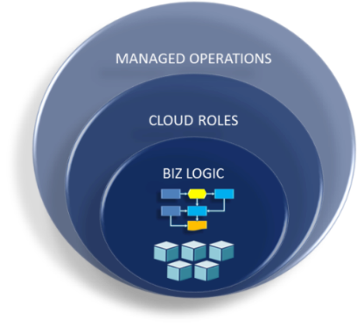



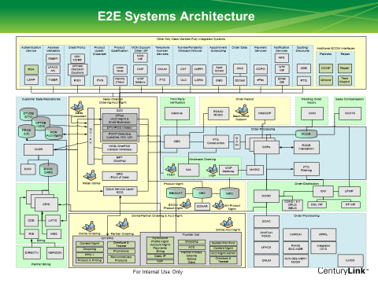
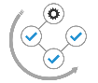
US Telco – Transformation Journey
Consumer Layer
Data Services
API Manager
Business Process Layer
Service Taxonomy
Data Platform
Federation
Legacy Apps Stills holds Business Logic
Legacy Apps
Legacy Data

Slide 60



US Telco – Transformation End State
Consumer Layer
Data Services Platform
Service Taxonomy
API Manager
Business Process Layer
Data Lake
Data Lake
DOCS
Data Platform
Micro-Services
Micro-Services inherits Business Logic
Legacy Data
Legacy Apps
Potential for App Rationalization/Retirement

Slide 61
Supply chain digitization through opensource technologies and domain driven design principles – Functional view
Transformation for a CSP in NA
Integrated Inventory Visibility across all stores and processes
Independent process Control & Compliances
Retail Inventory domain
Problem Statement
Cost Reduction
Improved Customer &User Experience
Better Inventory Planning
Reduce Shrinkage
Reduce Write offs]
Transfer
Receive
Sales
Improved Accountability
Returns
Physical Inventory reconciliation
Reporting
Lifecycle tracking
On-demand operational reporting
Lifecycle tracking of inventory item
Inventory threshold management
Analytics and business intelligence

Slide 62

Transformation for a CSP in NA
Supply chain digitization through opensource technologies and domain driven design principles – Functional view

Slide 63






TechM Microservices Assessment Framework
Phase 1- Investigate
Phase 2- Model
Phase 3- Prioritise
Phase 4- Actionable Plan
Goals & Objectives
Verify and Validate Data
Filter Application as per for PoC criteria
Technology Stack Finalisation
Business Impact
Micro services migration assessment
Identity the integrating applications if any
Finalise deployment & Scaling Options
Current application issues
Fitment against various Design patterns
Finalise the Technology Stack
Future State Capacity planning
As-Is and Target Technology Mapping
Analysis deployment models
High level migration & Testing strategy
TCO / ROI Calculations
Gathered Data
Analysis
Testing and New platform Transition plans
Cloud & Open Source Migration Strategy
Next steps – Road map
Data Gathering
Base Data
Base Data
Application Details
Goals & Objectives
Application characteristics
Technology Stack and Capacity plan
Target Technology Standards
Application Readiness
Data sensitivity and Other security Details
Application Integration Details
Stakeholder Acceptance
TechM Team
Program Managers
Business Consultants
Technical Architects
Solution/Application Architects
Microservices and Containerisation Specialists
Huawei Application Owners
Huawei Security Team
Huawei Infra Team
Huawei CXO Team
Huawei EA Team

Slide 64

Application Migration on Service Fabric

Slide 65

Worker Role to Stateless Service

Slide 66

Web Role to Stateless Service
Entry point API and lifecycle

Slide 67


Web Role to Stateless Service

Slide 68
Web Role to Stateless Service

Slide 69
Service Fabric Configuration settings

Slide 70
Thank you
Visit us at www.techmahindra.com

Slide 71
Key benefits and Challenges

Slide 72
Benefits of Microservices
Streamlined Orchestration
DevOps can be narrowed to automate each individual service with less complexity.
Quick Iterations
Impact analysis stops at boundary
Less risk on re-write
APIs can be versioned more effectively
No dependency on particular programming language and easy to choose any programming language like Java, Python, Node.JS etc.
Scaling at the individual service level becomes more cost-effective and is elastic on demand.
Effective Scalability
Versioning
Language Flexibility
Rewritten can be limited to one service
Provides firm module boundaries with explicit interface
Environments can remain consistent from development to staging to production, with less configuration management.
Developers can be more focused on specific tasks
Pushing updates means deployment process for a specific service, leading to more agile capabilities.
Individual tasks can be processed concurrently without affecting the application
Major releases can be done at the application level, while services can be updated on-demand
Eliminates Single Point Of Failure
Separating components of an application makes it less likely that an individual bug or hardware failure
Failed processes can be isolated, and down endpoints can be retried until reached
Harder to violate boundary in development
Decentralized choreography
vs Central Orchestration
vs Central point of failure

Slide 73
Challenges of Microservices
Complex Orchestration
Inter-service Communication
Decoupled services need a reliable, effective way to communicate
Data Consistency
Maintaining High Availability
Microservices provides more effective isolation and scalability; however, the uptime of each service contributes to the overall availability of applications.
Testing
Services will often need to communicate with each other or rely on a data source or API. Testing one service independently would then require a complete test environment to be effective.
More services means maintaining more deployment flows.
Multiple replicated databases and constant data delivery can easily lead to inconsistencies without the proper mechanisms in place.
DevOps takes more important role with this pattern, as each service must be configured properly across its entire lifecycle.
Delivering data over the network introduces latency and potential failure
A common approach is to introduce a message queue as a reliable transport layer.
Each service must then have its own distributed measures implemented to ensure application wide availability.

Slide 74
Canadian Bank – Accounting Application
Application Overview
Back-office Accounting and P&L calculation and reconciliation system supported by a Trade and Accounting data warehouse.
The goal is to aid Scotia Capital in its capacity to close books on a daily basis, and eliminate intensive month-end efforts.
Due to the highly fragmented nature of Scotia Capital’s numerous systems (K2, Anvil, Camera, etc.), application acts to consolidate this disjoint data to create a standardized and logical data model, interface, and analysis solution
Business Use cases
P& L Calculations
Recon Engine
Data consolidation
Transactional/User scale
100 to 150 concurrency with Global users
Implementation/Transformation
Phase 1 – Pilot in progress
Full Scale deployment by End of Year

Slide 75
Pre-Sales Management Application US Telco
Business Use cases
Solution Assessment
Service Information
Service Availability
Exceptions management
Solution Design
Configure site types
Validations (Address &Speed)
Review management
Pricing Preview
Generate quote
Price summary
Transactional/User scale
200 concurrency with Global users
Implementation/Transformation
Pilot launched on Pivotal Cloud foundry
Subsequent phases in progress
Plans to migration to AWS ECS

